Slide 1
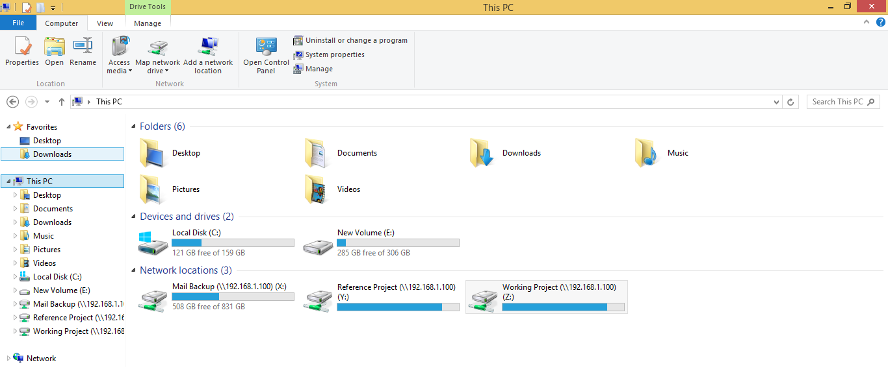
Folder System
Reference Project: All Completed Projects & Libraries
Working Project: All On-Going & Up-Coming Projects

Slide 2
Folder System
Working Project
Folder ID

Slide 3
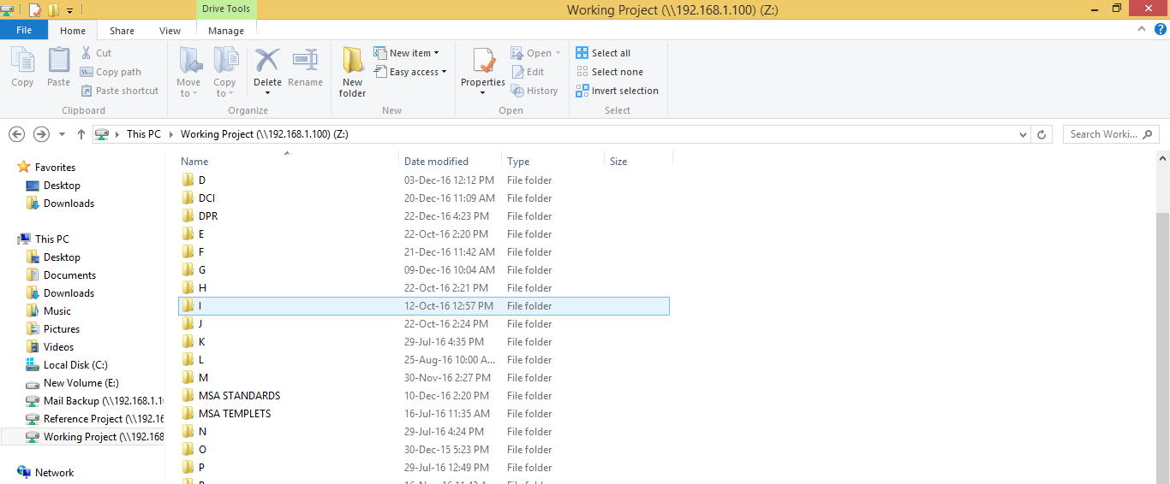
DPR: DPR of Staff
MSA STANDARDS: MSA Central Page

Slide 4
Folder System
Working Project
Folder ID

Slide 5
Main Folder Naming:
Client Name

Slide 6
Main Folder Naming:
Project Type
BT: Bus Terminal

Slide 7
Main Folder Naming:
Project Discipline
ARC: Architecture

Slide 8
Main Folder Naming:
Location of Site
NAV: Navsari

Slide 9
Main Folder Naming:
Project Code
16: Year
28: Project Number

Slide 10
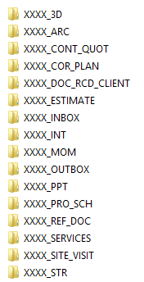
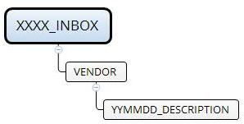
3D: 3Ds
ARC: Architecture Drawings
CONT_QUOT: The quotations that are received from the contractor
COR_PLAN: Corporation Plan
DOC_RCD_CLIENT: Documents received from client
ESTIMATE: Project Estimates
INBOX: Documents received from PMC, Site, Consultant etc.
*File naming: RCD_CLIENT_DATE_FILE TITLE
* = To be Obsolete

Slide 11
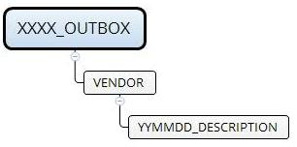
INT: Interior Drawings
MOM: Minutes of Meeting documentation
OUTBOX: Documents sent to PMC, Site, Consultant etc.
*File naming: SNT_CLIENT_DATE_FILE TITLE
PPT: Presentations
PRO_SCH: Project DCIs
REF_DOC: Reference documents
SERVICES: Services’ Drawings
SITE_VISIT: Photos of Site visits
STR: Structural Drawings
* = To be Obsolete

Slide 12
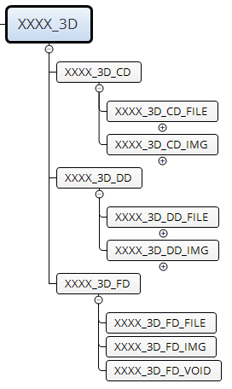
CD: Conceptual Design
DD: Design Development
FD: Final Design

Slide 13
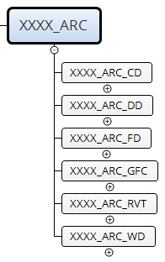
CD: Conceptual Design
DD: Design Development
FD: Final Design
GFC: Good For Construction
RVT: Revit Files
WD: Working Drawing

Slide 14
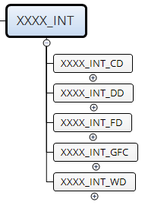
CD: Conceptual Design
DD: Design Development
FD: Final Design
GFC: Good For Construction
WD: Working Drawing

Slide 15
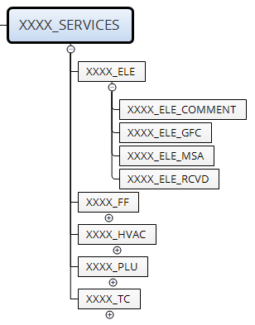
ELE: Electrical
FF: Fire Fighting
HVAC: Heating, Ventilation & Air-conditioning
PLU: Plumbing
TC: Tele Communication
GFC: Good For Construction
RCVD: Received

Slide 16
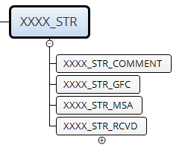
GFC: Good For Construction
RCVD: Received

Slide 17
Drawing Code Format:
Project Code

Slide 18
Drawing Code Format:
Project Discipline
ARC: Architecture

Slide 19
Drawing Code Format:
Project Stage
CD: Conceptual Design

Slide 20
Drawing Code Format:
Drawing Number as per DCI

Slide 21
Drawing Code Format:
Revision Number as per DCI

